Slide 1
Introduction to Chip Varistor
Oct. 2003
AMOTECH Co.
www.amotech.co.kr

Slide 2
Key Highlights
General information of ESD
What is the Varistor?
Comparison : Varistor vs. TVS Diode
Application of Chip Varistor

Slide 3
What is ESD?
General Information of ESD
ESD (Electro-Static Discharge) is the transfer of electrical charge between any two objects.
Difference between ESD & other transient events is rising time.(<< 1ns, others >>1 μsec)
→ Fast responding time of ESD suppressor
Not lethal to humans, but can damage or kill electronic devices during production or in the field
→ ESD suppressor must have large capability
of energy dissipation.
ESD exists EVERYWHERE
→ Unevenness parts of Mobile phone act as a
path of ESD currents.
100%
Current(A)
0.7-1 ns
30 ns
60 ns
Rise Time
Fig 1. Standard ESD waveform

Slide 4

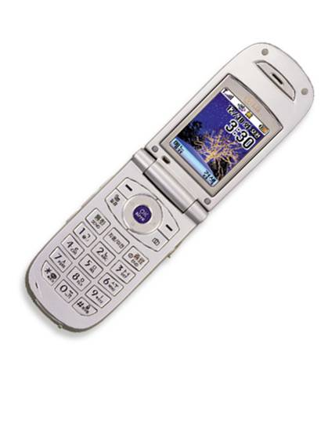
General Information of ESD
The Human Body Model
Human body model is used in IEC’s test specification for determining that systems are
susceptible to ESD events.
Circuit board
Data Line
IC
ESD Current
Human body can generate
ESD voltages is in excess of 15,000 V
maximum ESD protection
levels of 2,000V
ESD Damages

Slide 5
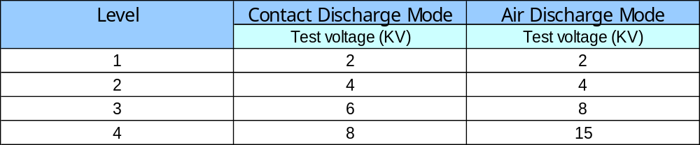
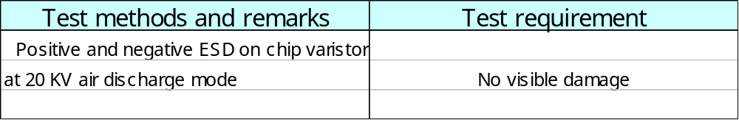
ESD testing requirement
General Information of ESD
IEC 61000-4-2 Standard
Test condition
ESD Simulator : Noise-Ken EES-630A

Slide 6
ESD Damage Categories
General Information of ESD
Once an ESD transient is discharged into an electronic system, there are three general
types of adverse effects .
Types | Symptoms | Solution | Remark
Soft failure | Data corruption System latch up | Data correction Rebooting | Temporary problems
Latent defect | Premature failure due to defective components | - | Partial degradation of component in system
Catastrophic Failure | - Junction breakdown - oxide failure - interconnects melting | - | Inoperable system
Table 1. General types of ESD damage.

Slide 7
Principle of ESD suppression
General Information of ESD
Varistor protect the circuit by “clamping” the transient voltage to a safe level, above circuit
operating voltage.
The energy that would have gone into the circuit is dissipated by the Chip varistor.
Circuit board
Data Line
Energy that the circuitry
would have experienced
IC
Voltage (log V)
Reduced
ESD Current
Clamped waveform
by varistor
Time (s)
Fig 2. Electronic device- chip varistor clamps the
transient thus limiting ESD current to the chip
Fig 3. Comparison of ESD waveform

Slide 8
Key Highlights
General information of ESD
What is Varistor?
Comparison : Varistor vs. TVS Diode
Application of Chip Varistor

Slide 9
Definition of Varistor
What is varistor?
Varistors (Variable Resistors) are voltage –dependent resistors with symmetrical
V/I characteristic curve whose resistance decreases with increasing voltage.
Surge Voltage (V)
I = K · V^{α}
α: Steepness
Surge current (I)
Max. permiable
Operating Voltage
Protection
Level
Fig 4. Typical V/I characteristic curve of Varistor
Fig 5. Circuit diagram symbols for a varistor

Slide 10
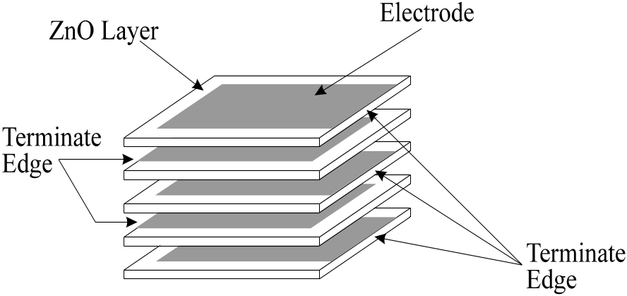
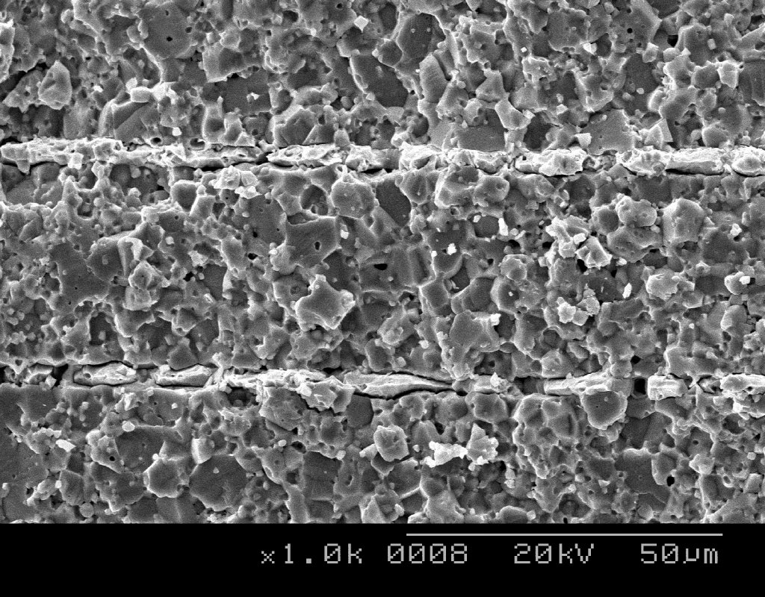
What is varistor?
Structure of varistor
Multilayer chip varistor is manufactured by interleaving metal electrodes and Zinc Oxide
Ceramic layers like MLCC structure.
ZnO Layer
Electrode
Terminate
Edge
End
termination
Fired ceramic
body
Terminate
Edge
Volume control ∝ Energy Absorption
Thickness control ∝ Protection Voltage
Area control ∝ Current handling capability
Fig 6. Internal construction of Multilayer chip varistor

Slide 11
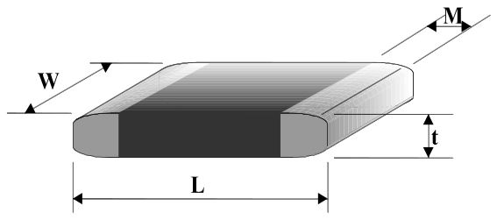
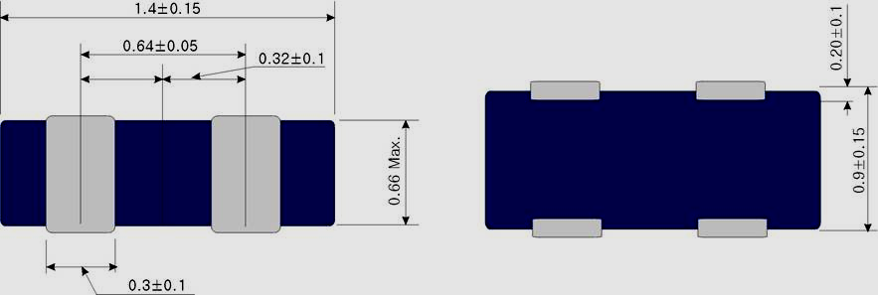
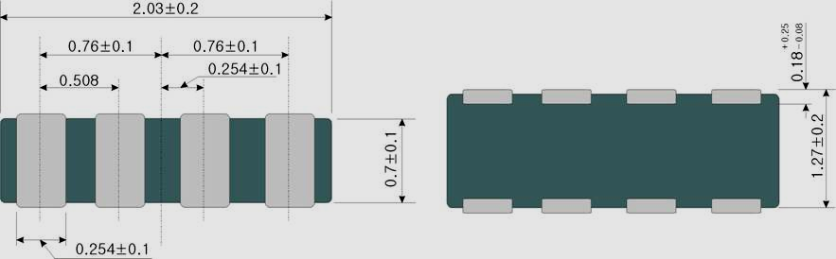
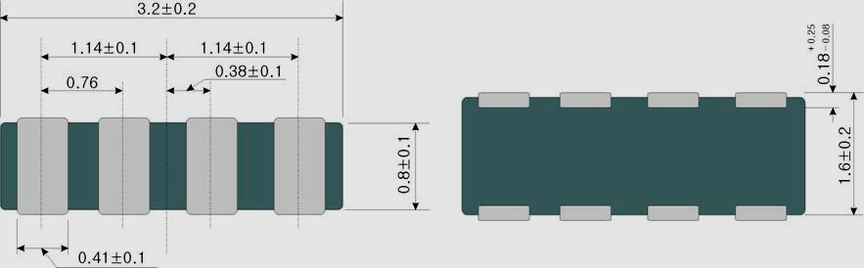
Dimensions of chip varistor
What is varistor?
0405(1210) Dual Array
0508(2012) Quad Array
0402(1005) Size
L = 1.0 ± 0.1 mm
W = 0.5 ± 0.1 mm
tmax = 0.6 mm
M = 0.25 ± 0.15 mm
0612(3216) Quad Array
0603(1608) Size
L = 1.6 ± 0.15 mm
W = 0.8 ± 0.15 mm
tmax = 0.9 mm
M = 0.35 ± 0.15 mm

Slide 12
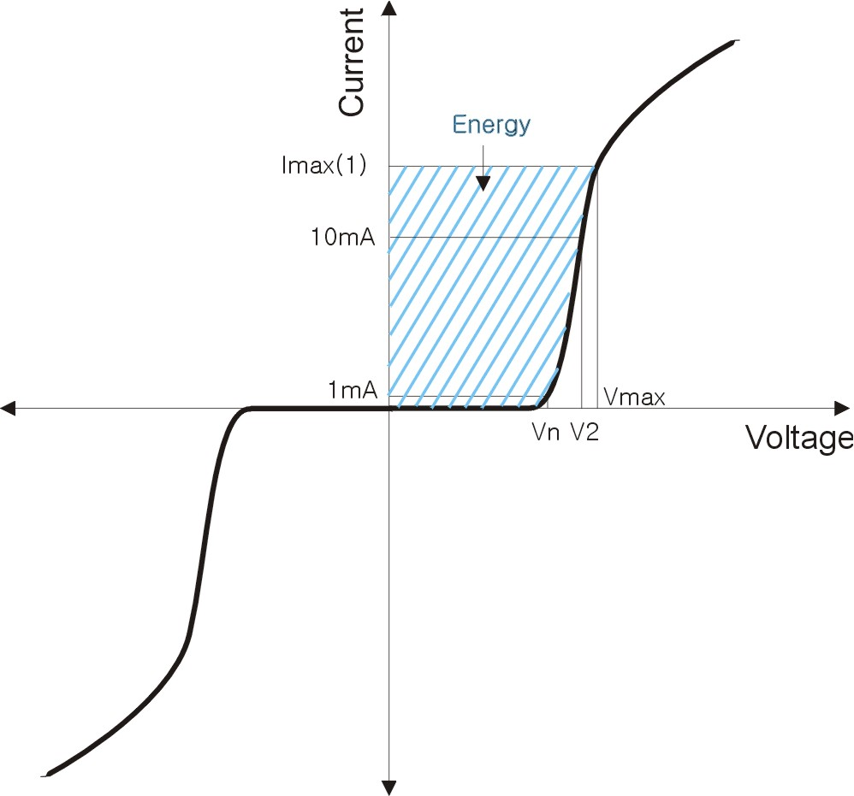
Terms and Descriptions
What is varistor?
Electric property items for varistor
  Varistor voltage (Nominal voltage, Breakdown voltage )
  Nonlinear coefficient
  Leakage current
  Capacitance
  Clamping voltage
  Peak current
  Insulation resistance

Slide 13
Electric properties of Varistor
What is varistor?
Varistor voltage (Breakdown voltage, Vn)
  The varistor voltage is the voltage drop across the varistor when a current of 1 mA is applied to the device
  Varistor voltage change according to sintering temperature and distance of internal electrode etc.
  So with a change of operating DC voltage, decide the varistor voltage specification.
Leakage current (IL)
  In the off state, the V/I characteristics of varistor approaches a linear (ohmic) relationship.
  The chip varistor is in a high resistance mode (approaching 106 Ω) and appears as a near open circuit.
  This is the amount of current drawn by chip varistor in its non-operational mode, i.e., when the voltage applied across the chip varistor does not exceed the DC working voltage or AC RMS voltage.

Slide 14
What is varistor?
Capacitance (Cp)
  Chip varistor behave like capacitors with ZnO dielectric.
  Chip varistor is constructed by building up a composite assembly of alternate layers of ceramic material and metal electrode.
  Since capacitance is proportional to electrode area, and inversely proportional to thickness between electrodes, the lower voltage chip varistor have a higher capacitance.
Clamping voltage (Vc)
  This is the peak voltage appearing across the chip varistor when measured for an 8/20㎲ impulse and specified pulse current.

Slide 15
What is varistor?
Peak current (Imax)
  The peak current is ability to dissipate transient energy.
  This is achieved by the interdigitated construction of chip vairstor, which ensures that a large volume of suppressor material is available to absorb the transient energy.
Insulation resistance (IR, MΩ)
  After reflow soldering with chip varistor on PCB, measure the value that apply 3.6 DC voltage on both side of soldered varistor.
  Typically most of chip varistor has insulation resistance value of 1 GΩ, but after reflow soldering, decrease less than 1 MΩ.
  That is why at the case of reflow soldering with chip varistor in mobile phone, they have big problem that are data transmission error, and power off etc.
  There is for solution that is “Glass coating” on ceramic body of chip varistor, then prevent the decrease of insulation resistance after reflow soldering.

Slide 16
Mechanism of IR decrease
What is varistor?
During reflow soldering
Chip varistor
Solder paste
Grain boundary
Pore
Chip varistor body
Flux
PCB
Flux
PCB
Generally, insulation resistance of chip varistor decreases
when grain boundaries are attacked by flux during soldering,
because ionic conduction occurs through the flux layer

Slide 17
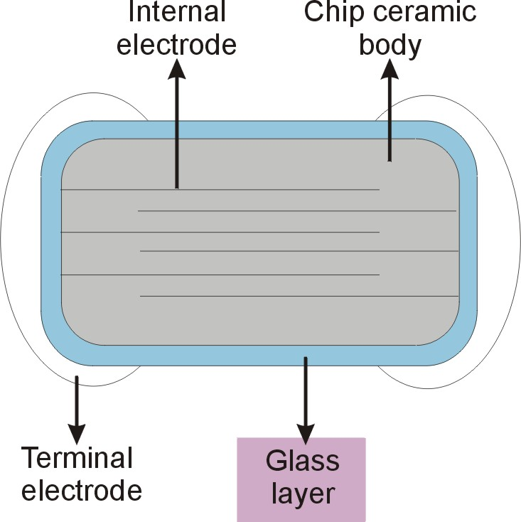
AMOTECH - Glass coating
What is varistor?
Characteristics of glass
  High humidity resistance
  High corrosion resistance
Advantage of glass coating
  To protect the ionic conduction
  by flux
  Insulation resistance increases
Original IR
＜ 1 ㏁
Improved IR
＞ 10 ㏁

Slide 18
Key Highlights
General information of ESD
What is Varistor?
Comparison : Varistor vs. TVS Diode
Application of Chip Varistor

Slide 19


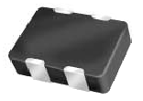
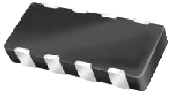
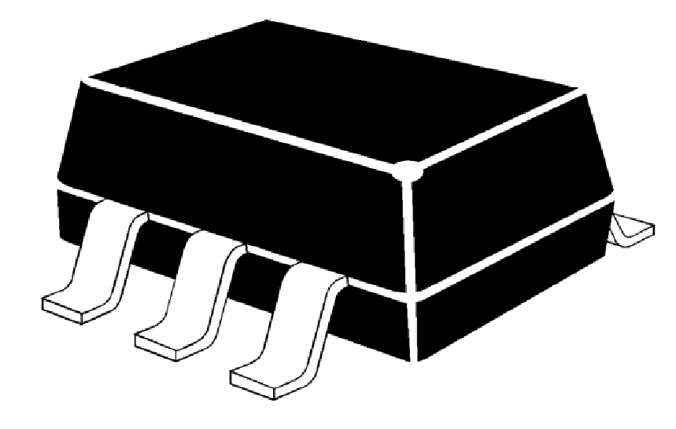
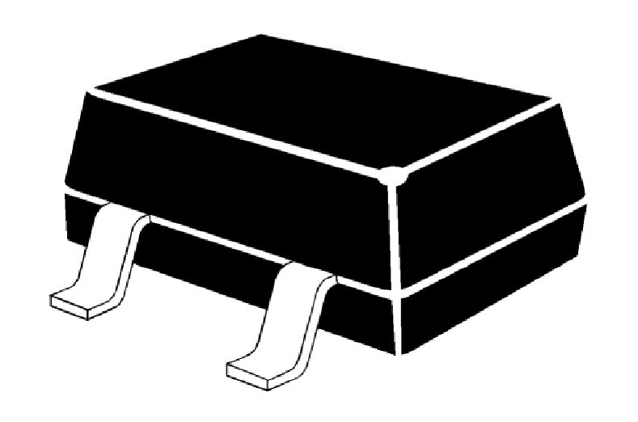
Variety of ESD Component
Chip Varistor vs. Diode
Chip Varistor
TVS Diode
Flip Chip Type
: Single/Array
Single Type
Array Type
Package Type
: Single/Array

Slide 20
Summarization of ESD Components
Chip Varistor vs. Diode
 |  | Advantage | Disadvantage
Chip Varistor |  | -. Bidirectional V/I Characteristic -. High Current Peak Handling -. No pulse temp. Derating -. High Peak Pulse Power -. Inherent Cap. Value for EMI Filter -. Fastest Response Time ( typ. 0.4 ns ) -. Smallest Size, Low Profile -. Low Price | -. Somewhat high Clamping Voltage
TVS Diode | Package Type | -. Low Clamping Voltage | -. Pulse Temp. derating from 25℃ -. Max. Peak Current reduced as Vn increase -. Slow Response Time ( > 1ns ) -. Big Size, High Profile
 | Flip Chip Type | -. Low Clamping Voltage | -. Pulse Temp. derating from 25℃ -. Max. Peak Current reduced as Vn increase -. Fragile -. Shinny Surface causing Frequent Pick-Up Error in SMT Process -. High Price

Slide 21
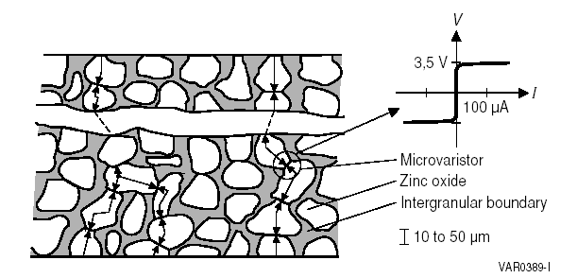
Basic Operating Principle
Chip Varistor vs. Diode
Schematic Internal Structure of Chip Varistor
Internal Electrode
: One P-N junction
ESD Components such as Chip Varistor and TVS Diode put to use above microvaristor characteristic.
Microvaristor show V/I characteristic as below, so that ESD can be passed through ground plane.
Below breakdown voltage range : R ⇒ ∞
Above breakdown voltage range : R < 10 Ω
cf.) TVS Diode : One P-N junction Layer
Chip Varistor : Several millions of P-N junctions that are connected serially and parallel
in a varistor body

Slide 22
Specification Comparison
Chip Varistor vs. Diode
Device Type | Size Type | Break down Voltage (Vn) | Clamping Voltage (Vc) | Peak Current (Imax) | Response Time (Tr) | Capacitance (Vr=0V, f=1MHz) | Dimension (mm)
Single Line Protection
Chip Varistor | 0402 | 6.4 – 9.6V | 15.5V | 20A | Typ. 0.4ns | 300pF | 1.0 X 0.5
 | 0603 | 6.4 – 9.6V | 15V | 30A | Typ. 0.6ns | 800pF | 1.6 X 0.8
Plastic Package | SC 79 | 5.7 – 7.8V | 10V | 5A | Min. 1.2ns | 30pF | 1.6 X 0.8
 | SOT 23 | Min. 6V | 9.8V | 17A | Min. 1.2ns | 400pF | 2.9 X 2.4
Flip Chip | 0402 | Min. 6V | 9.8V | 17A | Max. 1.0ns | 100pF | 1.0 X 0.5
Multi Line Protection ( 4 Line )
Chip Varistor | 0508 | 6.4 – 9.6V | 15.5V | 20A | Typ. 0.4ns | 300pF | 1.25 X 2.0
Plastic Package | SC 70 | Min. 6V | 9.5V | 12A | Min. 1.2ns | 150pF | 2.0 X 2.1
Flip Chip | 0408 | Min. 6V | 9.V | 17A | Max. 1.0ns | 100pF | 1.0 X 2.0
Vn Breakdown voltage or varistor voltage at 1mA DC
IL Leakage current at Vdc
Cp Capacitance at 1MHz
Vc Clamping voltage at 1A
Imax Peak current at 8/20 ㎲ waveform

Slide 23
ESD Immunity of ICs
Chip Varistor vs. Diode
The clamping voltage of Chip Varistor, however, is a little bit higher than that of TVS Diode,
it is much lower compared with inherent ESD immunity of semiconductor devices as shown below.
Device Type | ESD Susceptibility (Volt)
MSM Chip Set Series Melody Chip CODEC Chip LCD Driver CMOS ECL Schottky Diodes Bipolar Transistor | 2000 2000 2000 2000 250 ~ 3000 500 ~ 1500 300 ~ 2500 380 ~ 7000

Slide 24
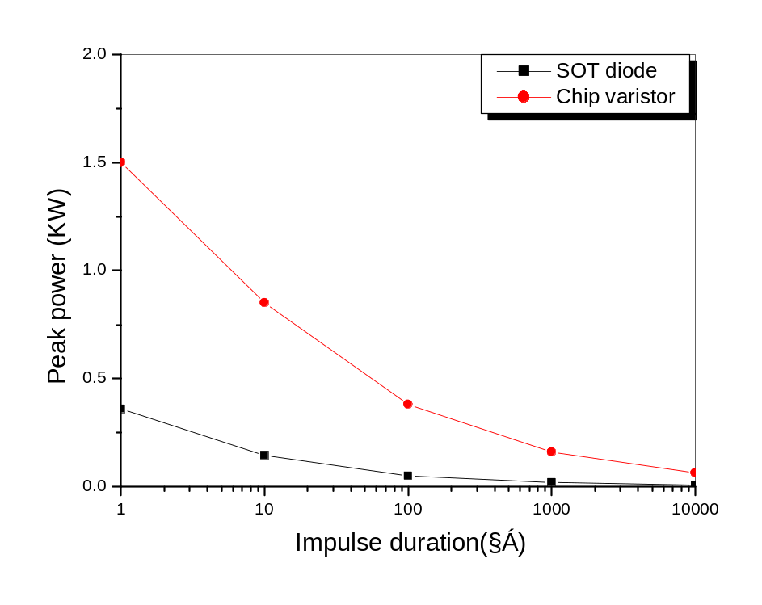
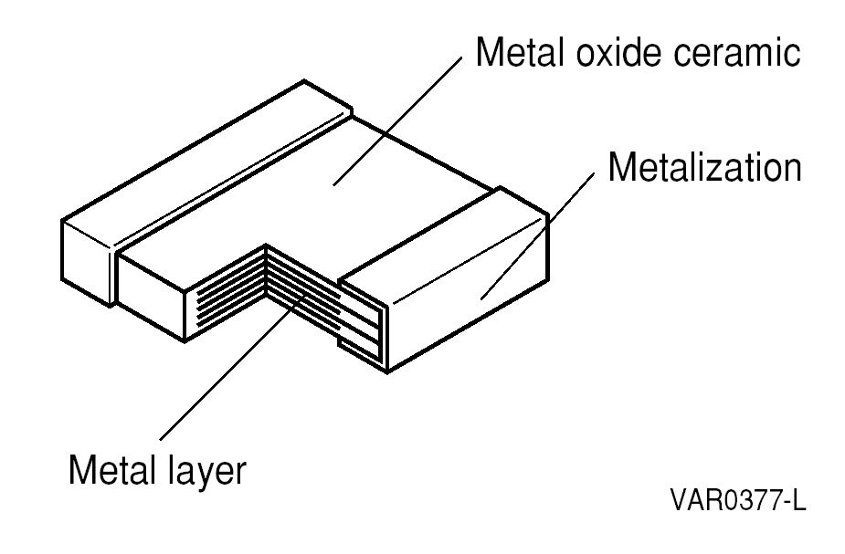
High Peak Current & Power
Chip Varistor vs. Diode
Compared with TVS Diode that has one P-N junction layer, A Chip Varistor with Multi-Layer Structure is made up of
several millions of P-N junctions shows higher Imax value and higher peak power value than TVS Diode.
Multi-Layer Structure of Chip Varistor

Slide 25
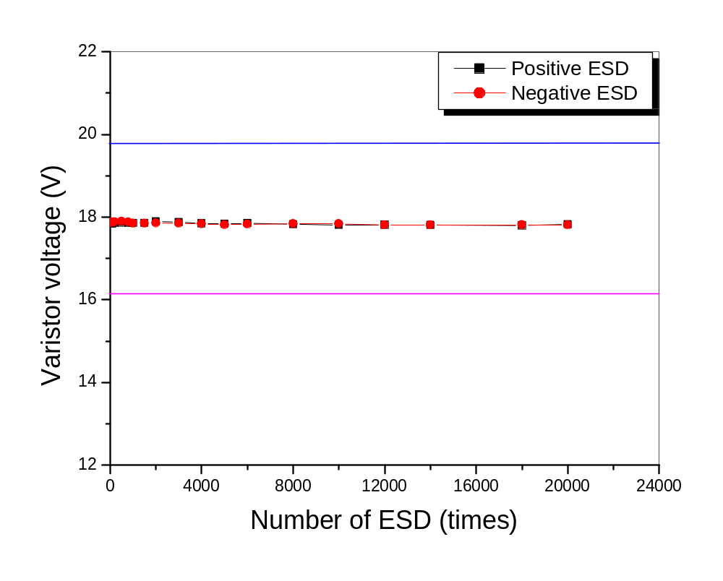
Result of ESD durability test
Chip Varistor vs. Diode

Slide 26
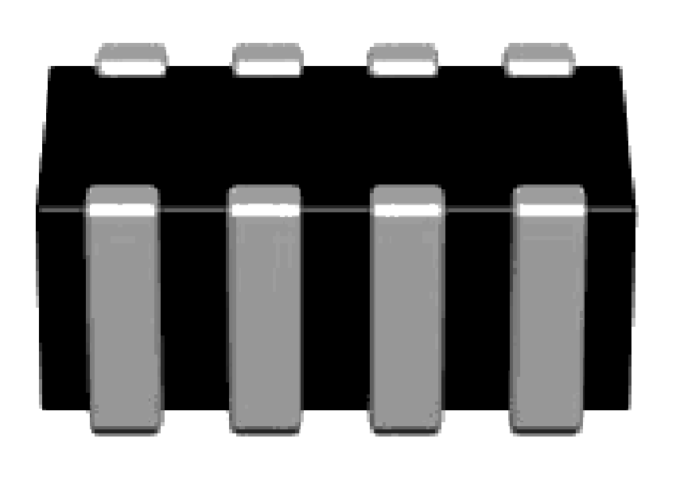
Smaller Size
Chip Varistor vs. Diode
However Flip Chip Type Array Diode has been introduced to compensate disadvantages of bigger size,
it is not only more expensive compared with chip varistor, but also problems in production line such as pick-up error
are reported.
4 line uni-directional protection
with array TVS Diode (SOT 23-6 series)
4 line bi-directional protection
with array varistor with 0508 series
Space Ratio
3.57 : 1.00
3.05 × 3.00 × 1.45 ( L × W × t, mm )
2.05 × 1.25 × 0.70 ( L × W × t, mm )

Slide 27
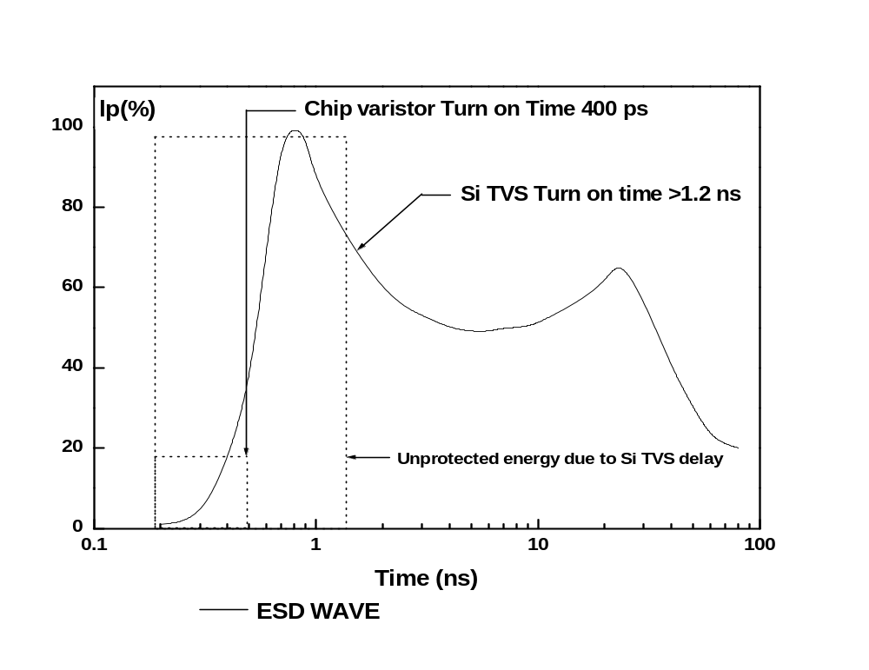
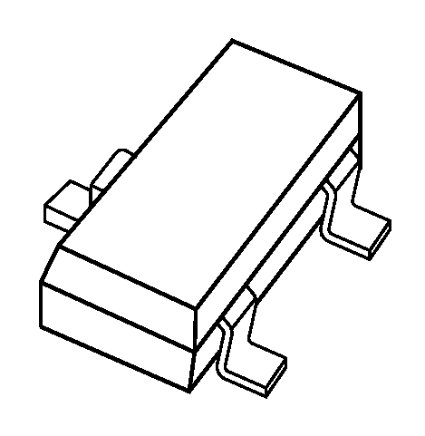
Response Time
Chip Varistor vs. Diode
Lead of TVS Diode Package has Inductance value, and this Inductance value causes delay of response time of TVS
Diode. ⇒ However Flip Chip Type Array Diode has been introduced to compensate disadvantages of response time,
it is not only expensive compared with chip varistor, but also problems in production line such as pick-up error
are reported.
TVS Diode SOT Package Series
Lead
Lead ⇒ Inductance Value
⇒ Delay of Response Time

Slide 28
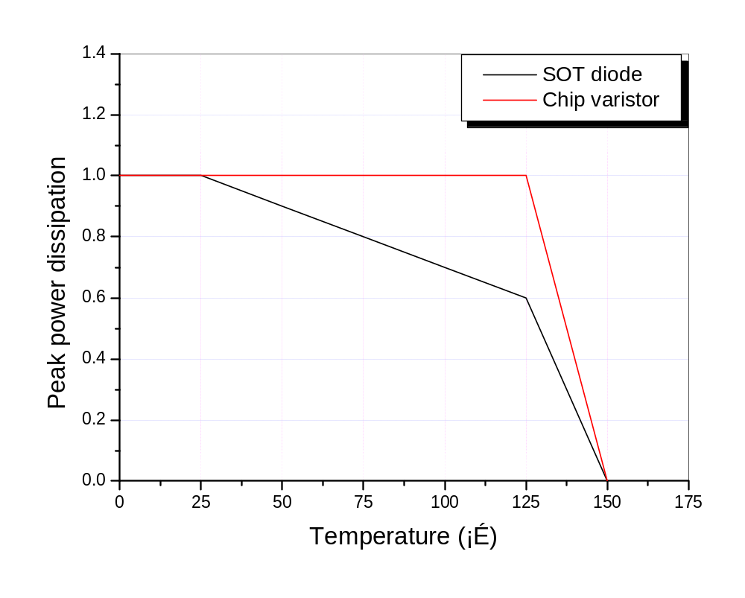
Typical Energy Derating vs. Temp.
Chip Varistor vs. Diode
Chip Varistor shows temperature independent characteristics up to 125℃,
but temperature characteristics of TVS Diode start to deteriorate from 25℃.

Slide 29
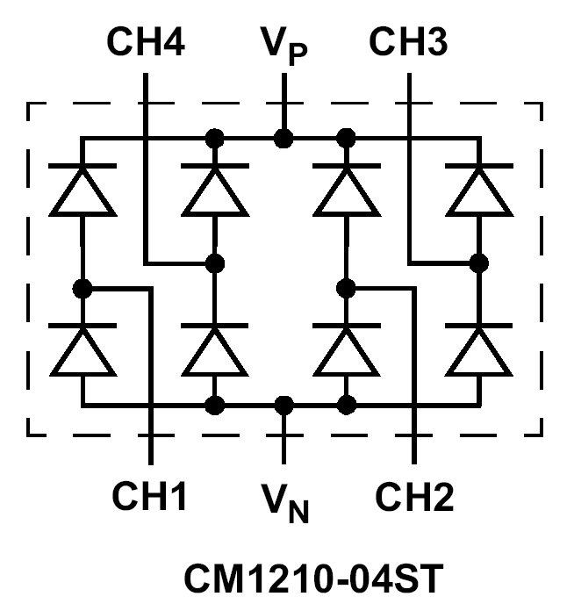
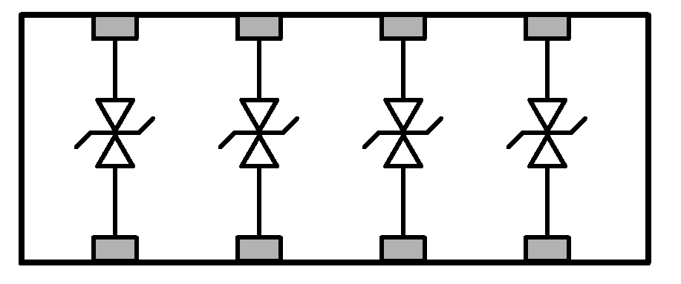
Cross-Talking
Chip Varistor vs. Diode
Interconnection among internal devices can give rise to inductive ESD on other parts of internally connected
parts. But the fact that Array Varistor has no interconnection among devices can clearly eliminate this problem.
4-Array Ceramic Varistor
4-Channel TVS Diode
No Interconnection
Interconnection
Common Ground
0508 Size (4-Array of 0402)
SOT 23-6 Package

Slide 30
Key Highlights
General information of ESD
What is Varistor?
Comparison : Varistor vs. TVS Diode
Application of Chip Varistor

Slide 31
Application field of chip varistor
MLV Application
Communication
- Cellular Phone/Cordless Phone
- PDAs
- Fiberoptic Boards
- Secondary Phone Line
- Fax Machine
Computer & Peripheral
- Note Book Computer
- Personal Computer
- Printers & Scanners
- HDD / CD ROM / DVD ROM
- Fax/Modems
- PCMCIA Cards
Chip Varistor
Consumer & Industrial
- Security Systems
- CATV
- Camcorder / Digital Camera
- Controllers
- Game Machine
- Bar Code Reader
Car Electronics
- ECU Protection
- On-Board Computer
- AV / Navigation Systems
- Electric Motor Control
- Multiplex I/O Line

Slide 32
MLV Application
AMOTECH Product Line-up
AMOTECH’S product line-up of varistors, ranging from single type to array one with various capacitance value, can offer total solutions for ESD protection in mobile phone.
Single type : 0402 size
Array type : 2-Array, 0405 (2 of 0402)
4-Array, 0508 (4 of 0402)
Low Capacitance Series (3 pF ~ 100 pF)
Effectiveness in ESD Protection
For effective design
For high data trans. rate
For ESD sensitive ICs
For longer battery life
Low Voltage Series : Vdc = 3 volt
Very low leakage current
: under 2micro-Amp

Slide 33
How to use chip varistor
MLV Application
ESD Current
BAD
IC
BAD
Placed Chip varistor at the
edge of the PCB, ground
directly using wide tracks
and multiple vias.
Route tracks through the
ESD suppressor.
GOOD
PCB

Slide 34
Selecting a AMOTECH varistor
MLV Application
The selection process of varistor requires a knowledge of the electrical environment.
When the environment is not fully defined, some approximations can be made.
Determine the necessary steady state voltage rating (working voltage)
: varistor working voltage ≥ operating voltage of circuit
Establish the transient energy absorbed by the varistor.
Formula: E= K·Vc·I·t
where K: const.,
Vc: Clamping voltage
t: impulse duration,
I: applied peak current
For system using high speed data rates, Varistor capacitance will have to
be considered.

Slide 35
Capacitance vs. Transmission Rate
MLV Application
1000
USB 1.1
USB 2.0
Capacitance (pF)
100
~25 pF
10
~4 pF
1
4
5
6
7
8
9
10
10
10
10
10
10
Transmission Rate (bps)

Slide 36
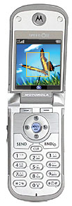
Application field – Mobile phone
MLV Application
Ear piece
LCD driver circuit
Antenna circuit
Ear phone jack
Volume Key
Key Pad
Interface connector /
Car kit connector
Battery connection
& Mouth piece

Slide 37
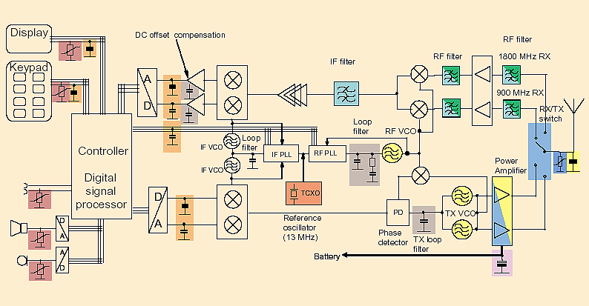
Application field – Mobile phone
MLV Application

Slide 38
Application Guide for Varistor
Application Part | MODEL | Voltage | Capacitance | Peak Current
 |  | (Volts) | (pF) | (A)
POWER Line | AVL 5M 03 300 | 8 | 800 | 30
 | AVL 8M 03 300 | 11 | 500 | 30
 | AVL 14K 03 300 | 18 | 350 | 30
 | AVL 18S 03 LC 120 | 22~28 | 120 | 30
 | AVL 5M 02 200 | 8 | 480 | 20
 | AVL 14K 02 200 | 18 | 160 | 20
Speaker, Receiver, Ear jack, Side key Microphone. | AVL 14K 02 200 | 18 | 160 | 20
 | AVLC 5S 02 050 | 10~14 | 50 | 10
 | AVLC 14S 02 100 | 18~24 | 100 | 20
I/O PORT, UIM/SIM | AVLC 5S 02 100 | 10~14 | 100 | 20
 | AVLC 14S 02 050 | 18~24 | 50 | 10
 | AVL 14S 02 200 | 18~24 | 100 | 20
USB 1.1 | AVLC 18S 02 015 | 24~32 | 15 | 5
USB 2.0 | AVLC 18S 02 003 | max 30 | 3 | 10
DATA LINE | AVNC 18S 05Q 015 | 24~32 | 15 | 5
DATA LINE for MSM6100 | AVNC 18S 05Q 003 | max 30 | 3 | 10

Slide 39
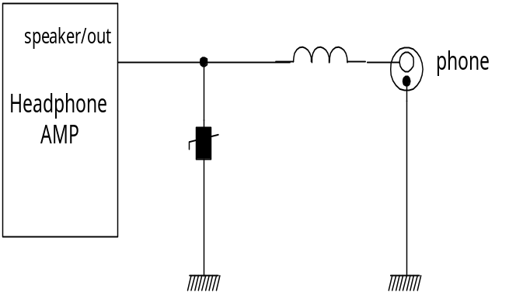
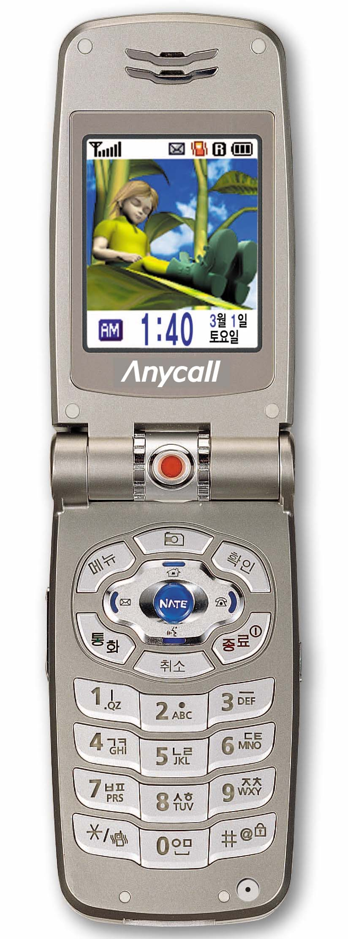
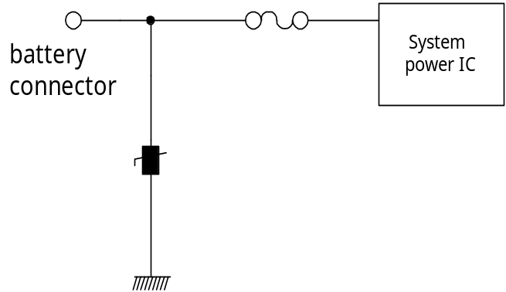
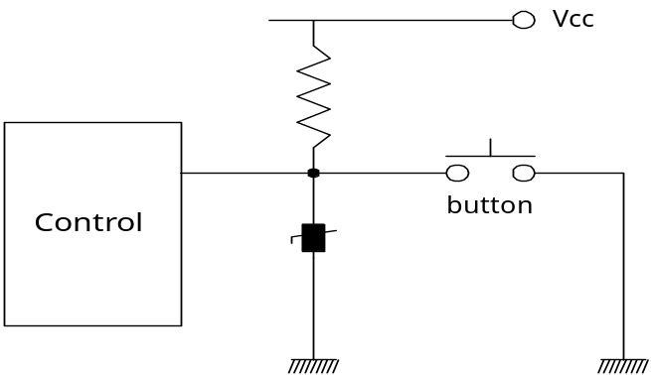
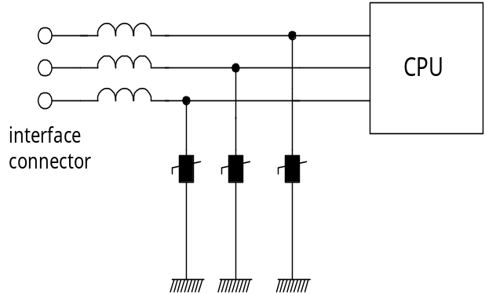
Electronic circuit for protection
MLV Application
Speaker jack protection
Power supply protection
Button protection
Data interface protection

Slide 40
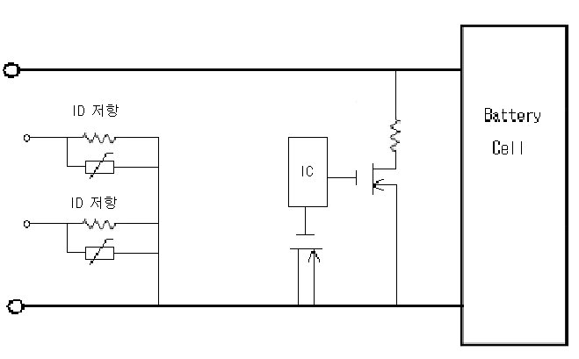
MLV Application
Battery Protected Circuit Module
1. To prevent variation of ID Resistance value
2. There is a possibility for generation of
ESD event when battery cell is
turned on and off.
→ Bigger I_{MAX} is more effective for this case.
→ 0603 sizes have Bigger IMAX than 0402 size.
3. Recommended model
→ AVL 18S 03 300 LC120
→ AVL 18S 03 300 171
ID
Resistor
Battery cell
ID
Resistor

Slide 41
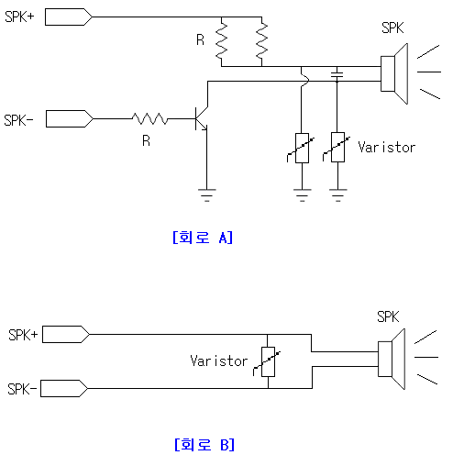
MLV Application
SPK(Speaker)
1. Protection of ESD which entered from Speaker
2. Low Cp value of varistor is available for [case A]
3. High Cp value of varistor is available for [case B] because it is using for common varistor.
4. Recommended Model
→ AVLC 5S 02 050 for [case A]
→ AVL 5M 02 200 for [case B]
[case A]
[case B]

Slide 42
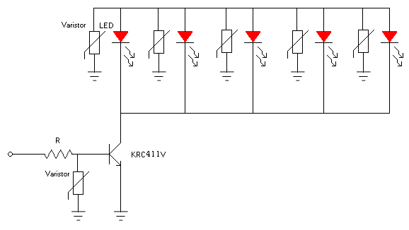
MLV Application
Hand Phone Keypad LED
1. Symptom: Applied varistors which have different I_{L} value result in difference of each LED’ brightness.
2. Solution: Guarantee for high IR after Reflow soldering. → Achieved by Glass Coating
3. LED has low protection level for ESD
( 400V ~ 500V)
4. Recommended Model
→ AVLC 5S 02 050

Slide 43
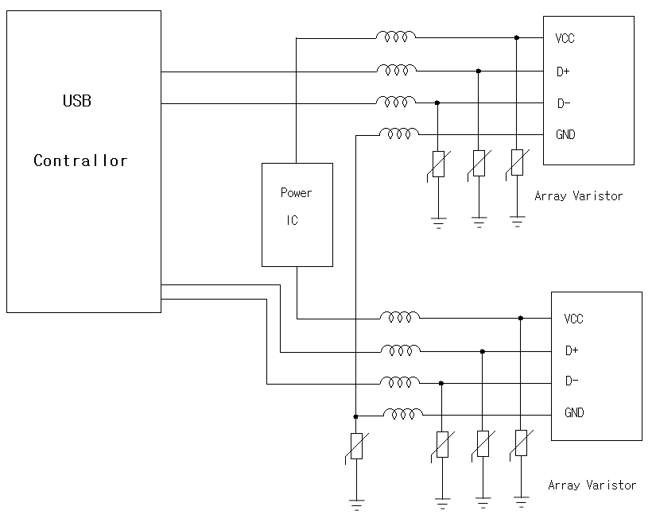
MLV Application
USB Interface
1. Consideration of Cp value
→ USB 1.1 : below 20 pF
→ USB 2.0 : below 4 pF
2. High Cp value can cause distortion of data form or reduction of signal intensity.
3. Recommended Model
AVLC 18S 02 015, AVNC 18S 05Q 015
for USB 1.1
AVLC 18S 02 003, AVNC 18S 05Q 003
for USB 2.0
AVLC 18S 02 001 for USB 2.0

Slide 44
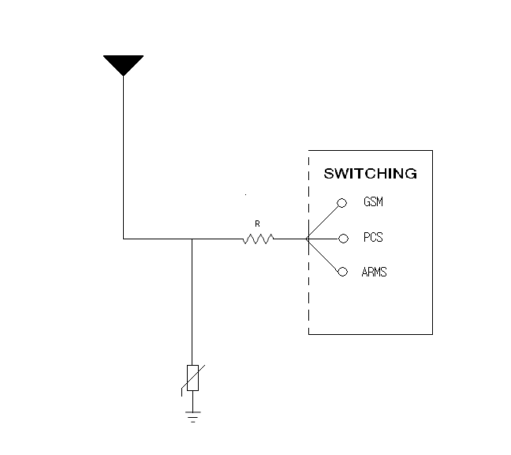
MLV Application
Antenna switch
1. Antenna easy to be a shortcut of ESD path.
2. High Cp value can cause reduction of
signal intensity.
3. Recommended Model
AVLC 18S 02 001
CDMA
PCS
GPS

